Slide 1
DRUŠTVO SPORTAŠA VETERANA I REKREATIVACA (DSVR) KICK OFF MEETING ACTIVE IN SPORT AGAIN!
Zagreb, 09.03.2020.

Slide 2
DRUŠTVO SPORTAŠA VETERANA I REKREATIVACA (DSVR)

Slide 3
DSVR
The DSVR Association was established in 2010 because of the quality implementation of projects and programs in the field of sports system in cooperation with healthcare, culture, and economy, based on countless experiences of prominent members of DSVR
Is a member of the umbrella sports organization in the City of Zagreb - Zagreb Sports Association
DSVR is the founder of the Society Foundation of Veterans and Recreational Athletes – its emphasis is on the health care of athletes in need
It counts approximately 200 member (top athletes and recreationalists)
Top athletes - Sports ambassadors of the Republic of Croatia - OLYMPIC, WORLD AND EUROPEAN WINNERS from around 40 sport disciplines with over 300 medals
The emphasis of all DSVR activities is raising awareness of the importance of sports activities for children and youth in order to improve their social, physical and health status

Slide 4
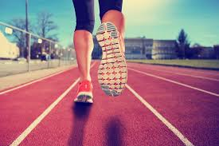
OBJECTIVES OF DSVR
Expanding awareness of the importance and necessity of doing sport and recreational activities throughout the entire course of life
Promotion of educational functions of sports and of sporting behavior (sportsmanship)
Expending the Olympic values and ideals
Development of sports ethics, fair play, humanity, and solidarity
To impact on the inclusion of as many women as possible in sports, sporting activities and management positions in the sports system (administrative boards, coaches, coordinators, organizers, etc.) regardless of the social status, and racial, religious and cultural affiliation...
Caring for the athletes in need after their top sports career

Slide 5
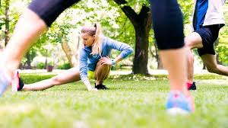
OBJECTIVES OF INCLUSION IN SPORT - SPORTS ACTIVITIES - RESULTS
Improving the health status a population from the youngest age
Development of socialization
Success in the sports segment
Equality and gender equality
Helping and respecting others
Promotion of moral values
Building a stable person through sports and sports activities for activities later in life

Slide 6
ACTIVITIES OF DSVR
Non-formal education of its members and wider public about the importance of sport and recreational sport activities by organizing lectures, seminars, public forums etc.
Participation at national and international conferences and recreational sport competitions for former athletes
Working with fans/supporters from various sports and clubs in order to combat violence and tackle racism, discrimination and intolerance in sports and around (e.g. at sporting events)
Development of sport and educational project
Organization of sport camps and competitions
Actively participating in policy making regarding health benefits for current and former athletes
Continuous cooperation with EU member states and other countries in order to promote sport for children and youth

Slide 7
COOPERATION OF DSVR AND OTHER INSTITUTIONS
Zagreb Sports Association
Central State Office for Sport
Croatian Olympic Committee
City Office for Sports and Youth
Faculty of Kinesiology, University of Zagreb
„Sport za sve”
National and local sports associations
Croatian and Zagreb Olympic Clubs
CCPA - Denmark - international NGO organization
BSDA – Bulgarian sports development association – Erasmus + „AS-A”
SFoA - Sports federation of Ajdovščina - Erasmus + „AS-A”

Slide 8
COOPERATION OF DSVR AND OTHER INSTITUTIONS

Slide 9
SPORTS ACTIVITIES IN ZAGREB, CROATIA
Population (of all ages) are included in:
70 sports
800 sports clubs
200 sport facilities (indoor and outdoor activities)
Mode of inclusion
Continuous informing of girls and boys from 1st grade of elementary school → Cooperation of sports system (HOO, national and local sports associations) and educational system of the Republic of Croatia
Educational panels and public forums intended for the youngest
Fellowship of former top athletes with girls and boys of the youngest age through school and club sports

Slide 10
ERASMUS+ SPORT Active in Sport Again!
COORDINATOR – LEAD PARTNER:
THE ASSOCIATION OF THE RETIRED ATHLETES AND RECREATIONISTS, ZAGREB, CROATIA (DSVR)
PARTNERS:
ASOCIACIA ZA RAZVITIE NA BULGARSKIASPORT, SOFIA, BULGARIA (BSDA)
SPORTNA ZVEZA AJDOVSCINA, AJDOVSCINA, SLOVENIA (SFoA)
PROJECT MANAGEMENT – 18 MONTHS (2020. – 2021.)
BUDGET: 53.250 EURA

Slide 11
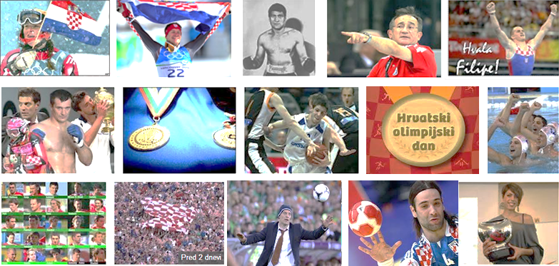
Thank you for attention!
www.drustvosportasaveterana.hr
E:drustvo@drustvosportasaveterana.hr

Slide 12
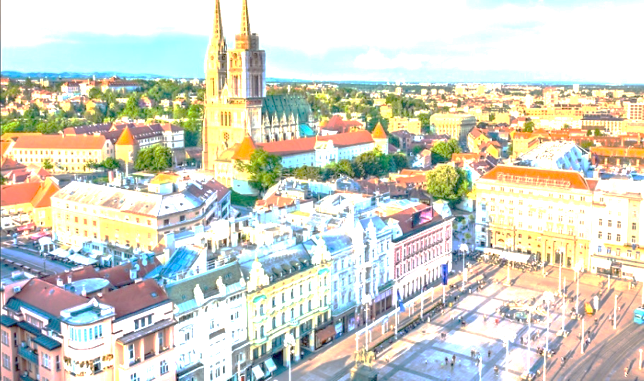
Dobrodošli u Zagreb!
Welcome to Zagreb!
Добре дошли в Загреб!
Dobrodošli v Zagrebu!

